Slide 1
LETS ACT
A Pathway to Racial Literacy: Using the LETS ACT Framework to Teach Controversial Issues
LOVE & LISTEN - EDUCATE - TALK – SEARCH
ANALYZE - CONCLUDE - TAKE ACTION

Slide 2
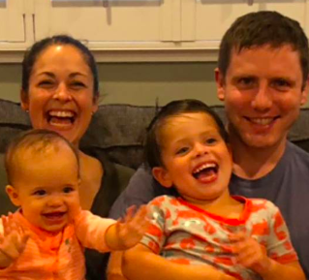
My Context & Positionality
Mother of 2 children
12-year elementary & middle school teacher
Guadalajara, St. Louis, Chicago
Doctoral student - University of Missouri - Social Studies & Literacy Education
I am part Mexican and speak Spanish, but I identify as White.
I try to look at the world and my research through critical lenses, but I recognize my own limitations as a white, cisgendered, able-bodied, upper-class woman, especially as I study controversial political issues that more often adversely affect people who are non-white, queer, lower-class, disabled.
I believe my work can be applied in many spaces, but I recognize that it may not be generalizable to everyone depending on their context.

Slide 3
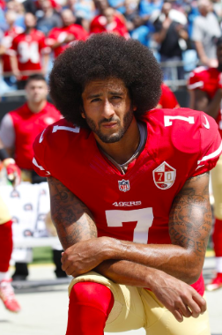
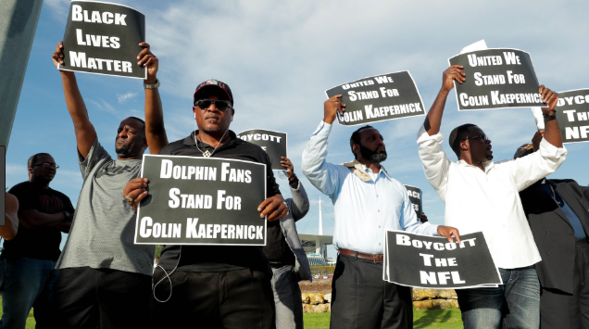
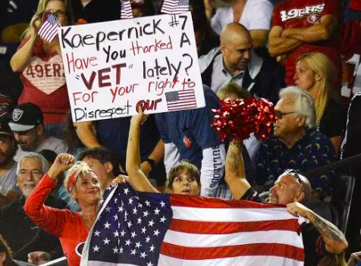

Slide 4
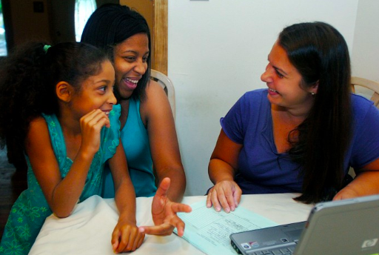
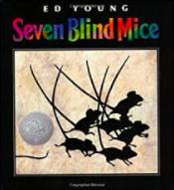
Love
Get to know your students on a deep level
home visits
background, traditions, heritage, languages, ancestry, values, etc.
Build community
Fun community building activities
Daily class meetings
Restorative justice circles
Student-as-expert mindset
Set a “Listening to Multiple Perspectives” Culture
Notes:
When you hear a perspective you don’t agree with, ask questions, listen and use respectful sentence starters.

Slide 5
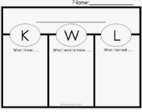
1. Listen
Listen to student prior knowledge:
Survey students individually
Assign reflective autobiographies around the critical issue
KWL charts
Email parents heads up
Notes:
Eliciting prior knowledge is a fundamental part of learning

Slide 6
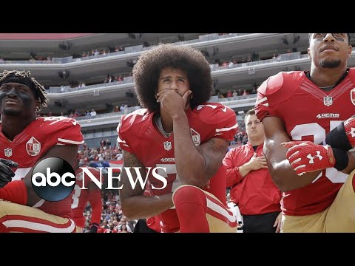
2. Educate
Do a vocabulary activity:
Protest
racial injustice
Patriotism
police brutality
First Amendment
Give background knowledge:
videos
news articles
photographs
radio
Notes:
Racial Literacy -

Slide 7
3. Talk
Facilitate an activity that allows students to talk in small groups in a way that allows them to discuss the issues, but does not force them to take a position—yet!
PRO-TakeAKnee
ANTI-TakeAKnee
After finished:
Legal vs. Moral perspectives
Factual vs. Misinformed perspectives
Notes:
Racial Literacy -

Slide 8
4. Search
Search within yourself (aka Reflect):
Activity
Discussion
Issue
Search the outside world (aka Inquire):
What questions do you have about the event or issue?
How can you find insights to these questions?
Organize a plan to investigate your questions.
C3 Inquiry Design Model = Template for guiding the process of searching & inquiring
Notes:
Reflection about experiences is strongest way for learning to stick
Important for introverted learners

Slide 9
5. Analyze
The current event
(Colin Kaepernick)
Remind students to continue their inquiry journals as they analyze the event and issue more deeply.
Historical context
(Racial injustice)
*Most important!

Slide 10
5. Analyze - How do you go deeper?
Children’s Literature
Historical Analysis
Consequence Mapping
Systems Thinking
Political Cartoons
Role play (see Dos & Don’ts Handout)
Media Literacy - Source Analysis

Slide 11
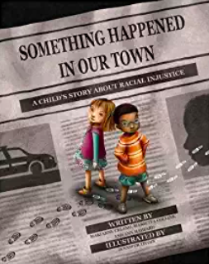
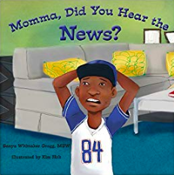
5. Analyze (Children’s Literature)
How do conversations about racial injustice tend to be different for different families?
Notes:
Who here has had “The Talk”?

Slide 12
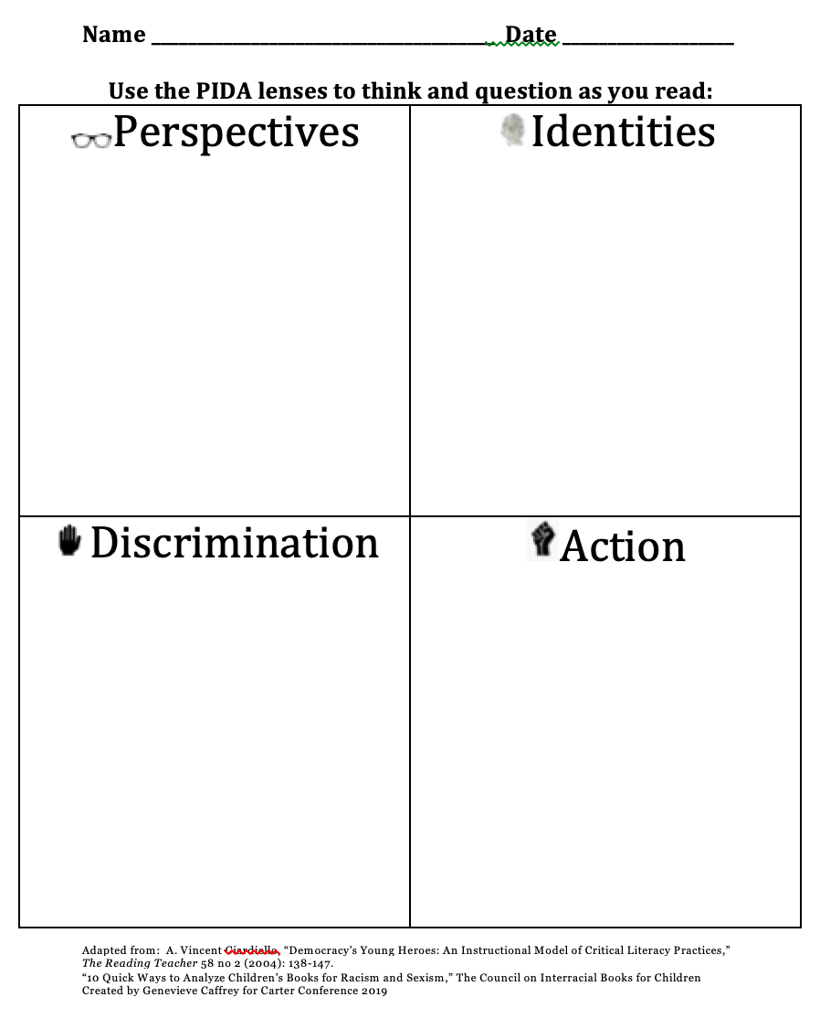
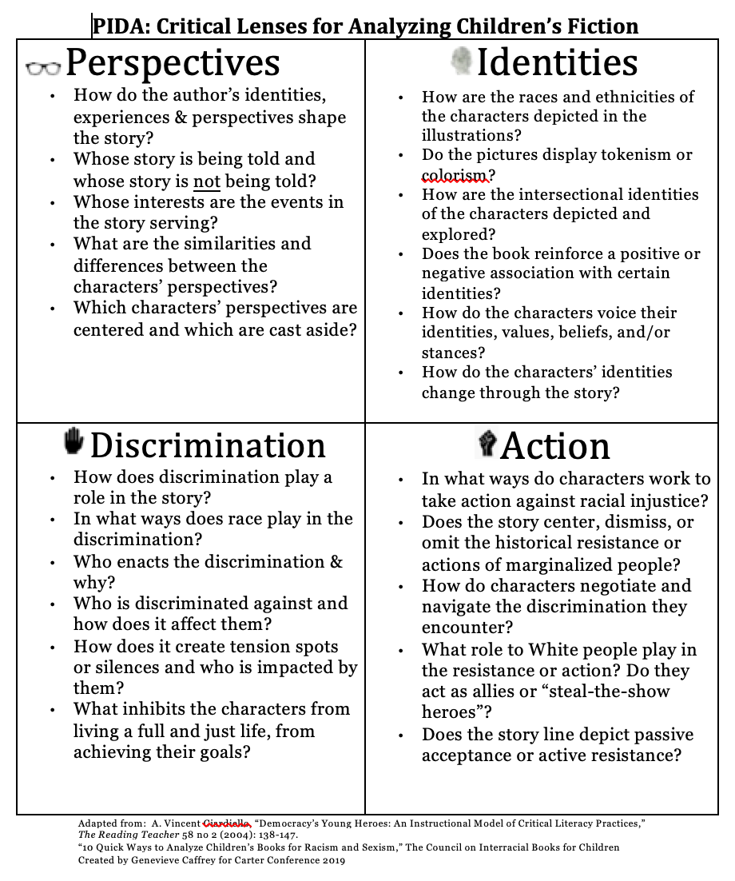
Use Critical Lenses to Read All Books

Slide 13
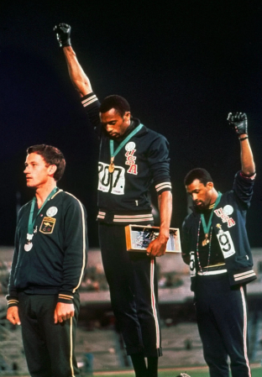
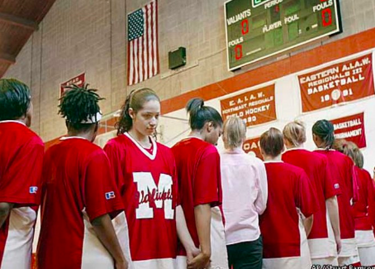
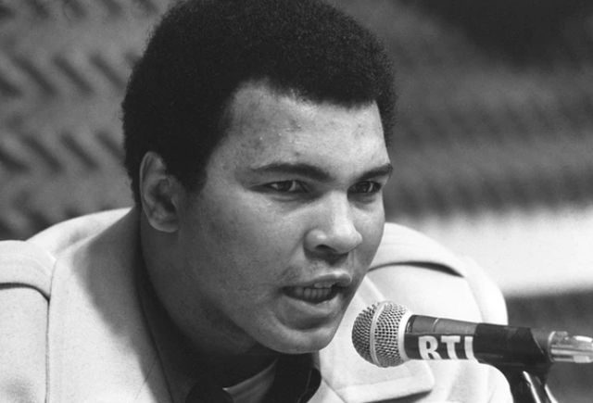
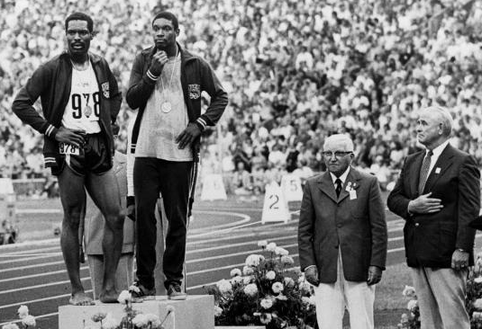
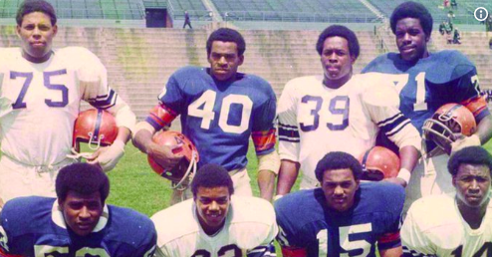
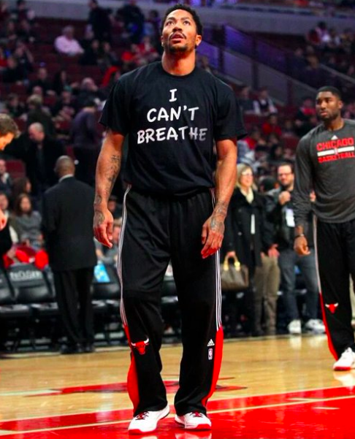
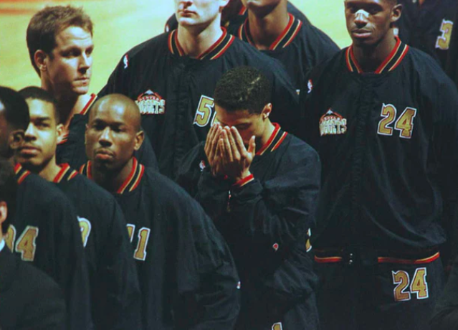
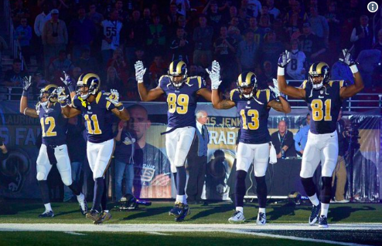
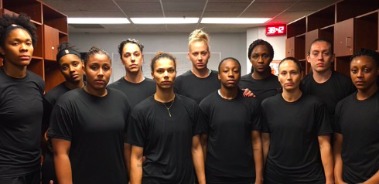
5. Analyze (History & Patterns)
Matching activity: What has changed? What has not?

Slide 14
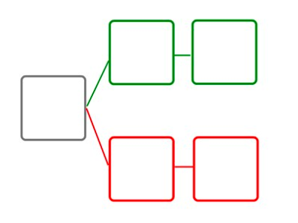
5. Analyze (Consequence Mapping)
Proposals:
Police officers required to have cameras on at all times.
Promote colorblind training for officers.
Write potential positive and negative consequences of a proposal. Think about unintended consequences of your own previous ideas.

Slide 15
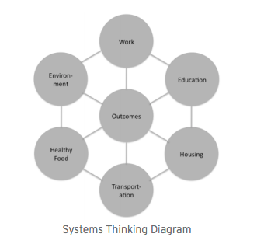
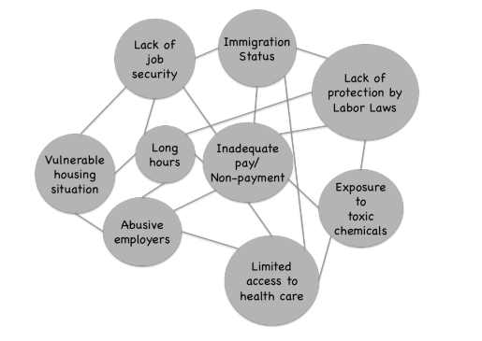
5. Analyze (Systems Thinking Tools - Waters Foundation)

Slide 16
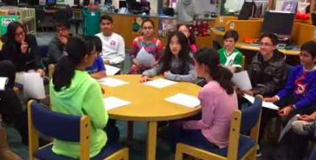
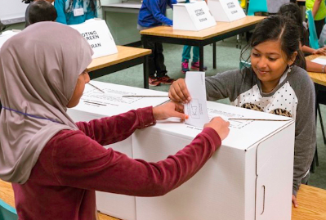
6. Conclude (through deliberation)
“Should Colin Kaepernick be suspended for kneeling?”
Deliberation Activity
https://www.facinghistory.org/resource-library/teaching-strategies/fishbowl
https://www.cultofpedagogy.com/speaking-listening-techniques/
Vote
Notes:
Teachers should remind students that regardless of who wins the vote, each student will have the opportunity in the next phase of the framework to take action in a way that supports their own opinion, even if it was a minority opinion. Although majority has strength in numbers, in democracies the minority can always work hard to take action and change minds.

Slide 17
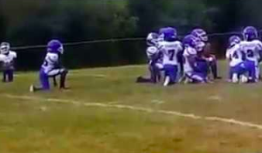
7. Take Action (and assess)
Writing assessment → Letter to the Editor
Create a film
Museum exhibit for the public
Awareness campaign
Fundraise
Protest
Community Issues Fair
Notes:
Give students the opportunity to brainstorm action ideas and outline action plans that support their conclusions around the issue. Given the breadth of ideological diversity typically found in classrooms, there will likely be multiple action plans reflecting dissenting views.

Slide 18
Controversy
What are our fears?

Slide 19
Controversy
Why do we do it anyway?

Slide 20
The Purpose of S.S. Education
“...to help young people make informed and reasoned decisions for the public good as citizens of a culturally diverse, democratic society in an interdependent world.”
-NCSS (1994), Expectations of Excellence: Curriculum Standards for Social Studies
Notes:
Many think it is to simply give students knowledge about the Constitution or U.S. system of government or Great American heroes to pass tests. 11% said “Problems facing the country today”
Another survey: (80%) Basic knowledge ; (64%) College/workplace preparation; (50%) Democratic education

Slide 21
The Health of a Democracy
“You cannot have a democracy without discussion. To be against discussion is to be against democracy.”
-Diana Hess (2009), Controversy in the Classroom
Notes:
There is an intrinsic connection between the discussion of controversial political issues and the health of a democracy. Schools have not just the right, but the obligation, to create an atmosphere of intellectual and political freedom that uses genuine public controversies to help students discuss and envision political possibilities.
DECREASE POLITICAL POLARIZATION

Slide 22
Job Security
NCSS C3 Framework:
(1) recognize societal problems,
(2) ask good questions,
(3) consider possible solutions and consequences
(4) communicate and act upon what they learn
-NCSS, 2013
CCSS: increased informational literacy
3rd grade standard: “Analyze how authoritative decisions are made, enforced, and interpreted by governments across historical time periods and current events” (MO 3rd grade).
Every state requires “regular S.S. instruction” (rec: 30-40 mins PER DAY; not required to share with science)
Notes:
Standardized tests assess students’ ability to identify bias, credibility of sources, write thesis statements, and provide evidence for claims.

Slide 23
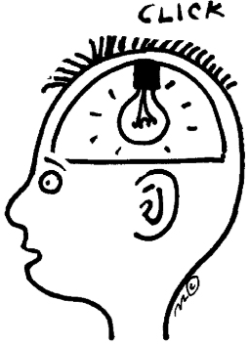
Content Knowledge
“Experimental discussion groups scored higher on the current events test and showed more improvement in their ability to analyze public issues discussions.”
-Johnston, et al. (1994), Improving civic discourse in the classroom

Slide 24
Critical Thinking & Moral Reasoning
“When students dialogue, not simply to win arguments, they develop into individuals who can examine their own beliefs, those of their own and other groups, those of their nation, and can do so with respect and understanding for others' values.”
-Noddings & Brooks (2017), Teaching Controversial Issues: The Case for Critical Thinking and Moral Commitment in the Classroom

Slide 25
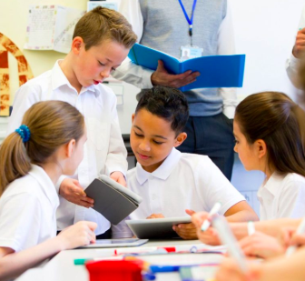
Classroom Engagement
“Participation and engagement in class increased considerably.”
-Ganzler et al (2007) Patriotism and ideological diversity in the classroom
Notes:
Discussion about politics makes the curriculum more authentic and relevant; This kind of learning is emotional → engagement
Issues tend to

Slide 26
Long-term Civic Engagement
Participation in deliberative dialogue predicted the following long-term behaviors:
news attention
issue salience
political discussion with parents and friends
size of discussion network
willingness to disagree and to listen to opponents
testing out opinions in conversation.
-McDevitt & Kiousis, Deliberative Learning
Notes:
practice

Slide 27
Conflict Resolution Skills
“Young children are indeed able to handle complex political and international conflicts. In fact, their conceptual sophistication for handling interpersonal conflicts seems to be enhanced by their work making sense of intergroup conflicts, in the context of social studies and across the curriculum.”
-Kathy Bickmore (1999), Elementary Curriculum about Conflict Resolution: Can Children Handle Global Politics?
Notes:
“It is so hard to solve problems in a climate where so many people are so sure their opinions are not just right, but it’s the only legitimate way to think.” -Diana Hess

Slide 28
Combat Bias & Prejudice
Children naturally develop biases as young as two years old (Hirschfield, 2008; Katz & Kofkin, 1997) and associate some groups with higher status than others as young as five years old (Dunham, Baron & Banaji, 2008). It is talking with children about controversial issues that helps them analyze their natural biases, question their assumptions, and develop skills to combat prejudice and stereotyping.
Bronson & Merryman (2009), Nurture shock: New thinking about children.
Notes:
“Political discussions familiarize people with legitimate rationales for opposing views. People become willing to extend important and significant rights to people who are different from oneself, which is especially important for highly diverse democracies.”

Slide 29
Combat Myths
When content is watered down, misrepresented even by well-intentioned teachers, or omitted completely because it is considered inappropriate, young people develop grave misunderstandings about the world or develop dangerous stereotypes and myths about other peoples and cultures.
-Christ (2018), Not an aberration of history: Genocide education in elementary social studies.
“Truth, regardless of how painful it might be, is always a better foundation to build on than a foundation of myth and misinformation.” -Crazy Horse (2002)

Slide 30
Combat Misinformation
Some Singapore geography teachers focused so much on the pedagogical goal of developing critical thinking that in teaching about climate change they misleadingly “present[ed] the science of climate change as an open issue and represent[ed] the arguments from both sides as equally valid.”
-Ho & Seow, 2015

Slide 31
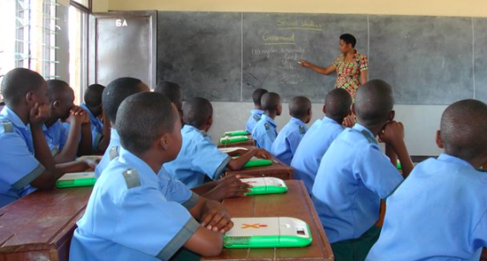
Combat Discrimination & Violence
After the horrific Rwandan Genocide in 1990s, the Rwandan government deliberately added in-depth controversial issues learning to their national elementary curriculum because they realized that discussing prejudice, discrimination, and controversial issues from a young age into adulthood could have possibly prevented the Rwandan genocide.
-Aegis Trust (2014), Peace education to enter Rwanda’s national curriculum.

Slide 32
Kids can handle it
Children as young as nine years old can investigate author bias, ask questions about apparently contradictory resources, make connections with their current world situation, and think about how authors can influence a historical event as it is developing.
-Henning et al (2006), Listening to children think critically about Christopher Columbus
Notes:
Children are little philosophers who have a keen sense of fairness. They all react differently

Slide 33
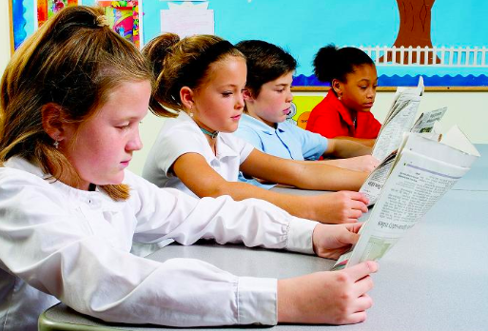
It may be hard, but kids need to handle it
“If some children have to be tough enough to be bombed and starved, other children can be tough enough to read about it.”
-Gangi (2014) Genocide in contemporary children’s and young adult literature: Cambodia to Darfur
Notes:
Can we really protect ALL of our students from traumatic knowledge & experiences? Why should some children have to feel trauma and others be protected from it?

Slide 34
Combat White Fragility
Avoidance of controversial discussions causes people—especially white people—to develop a fragility in which they feel entitled to stress-free environments…. This stems from a lack of meaningful cross-racial dialogue and, essentially, works to maintain racial inequality.
-Lukianoff & Haidt (2018), The Coddling of the American Mind
-DiAngelo (2006), “I’m leaving!”: White fragility in racial dialogue
Notes:
practice

Slide 35
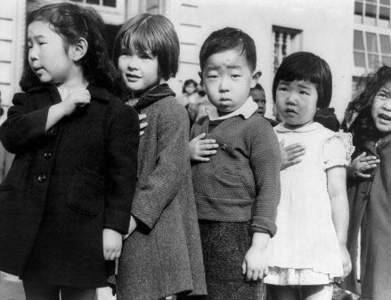
Affirm Identities & Experiences of Marginalized Children
When teachers suppress, ignore, or deny certain controversial current events or issues, they send a message that some people’s experiences are not important . . . we allow the dominant Eurocentric narrative to tell a “single story” that perpetuates stereotypes, prejudices, & misinformation about “the Other.”
-Naseem Rodríguez (2018), Hidden in history: (Re)constructing Asian American History in Elementary Social Studies Classrooms
-Adichie (2013), The Danger of a Single Story
Notes:
Oftentimes controversial news touches lives of those who are historically marginalized- White supremacist rallies, Colin Kaepernick/BLM protests (AA), President asks why we want people from “shithole countries”/tear gas at children at the border (immigrants), terrorism (Arab & Muslim people), transgender bathroom issue (LGBTQ), ----

Slide 36
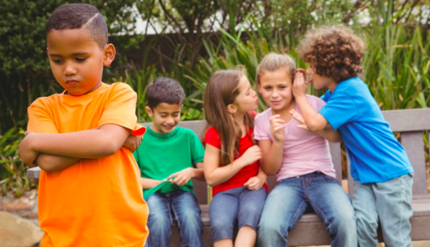
So We Don’t Leave Our Kids Out To Dry
Staying silent or merely brushing the surface leaves our students to navigate disturbing viewpoints on their own, which often results in more trauma than if the disturbing viewpoints were unpacked in the classroom with a teacher, discussion norms, and resources to look up evidence. Without guidance, children tend to repeat what they hear and echo the political polarization of our increasingly divided world.
-Hess & McAvoy, 2015

Slide 37
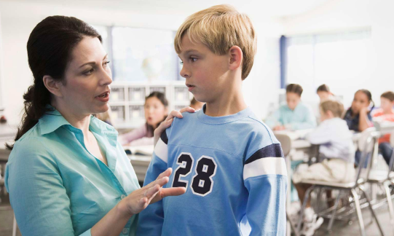
If a Kid Says Something Problematic, We Can Be There For the Kids It May Have Offended
We can pose follow-up questions (i.e., “What experiences have you had that led you to think that?”) or add evidence (“Hmmm...let’s go back to document C, what does the research say?” or “Johnny, can you go look that up?” Students and teachers can continue investigating and deliberating together, which doesn’t usually happen in the world outside classrooms. If blatantly disrespectful, then we can take disciplinary action.
-Sibbett (2018), Instructional Dilemma: What if Privileged Students' Views Harm Marginalized Peers?
Notes:
It’s riskier for your marginalized kids to not discuss controversial issues. Our marginalized kids have heard problematic statements about their identities already or will likely hear it soon. Classrooms are ideal spaces in which there has (hopefully) been community building, follow-up questions, range of resources/information available, dialogue, & deliberation.

Slide 38
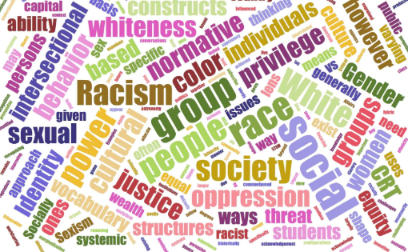
Develops our Racial Literacy
Racial Literacy is the capacity to conjugate the grammar of race in different contexts and circumstances.
“All Americans need to be better schooled in the subtle yet complex ways that race actually works in the 21st century. Talking about race involves a nuanced approach to identifying racism, beyond the overt displays of outright bigotry, to see how race operates in social structures and individual biases. Seeing—and reading—the racial hierarchies that privilege some racial groups and marginalize others is a necessary step in building our racial literacies and dismantling socio-political inequities.”
-Lani Guinier, (2004). From racial liberalism to racial literacy: Brown v. Board of Education and the Interest-Divergence Dilemma
Notes:
“Political discussions familiarize people with legitimate rationales for opposing views. People become willing to extend important and significant rights to people who are different from oneself, which is especially important for highly diverse democracies.”

Slide 39
Some general tips:
DOs:
Build family trust (home visits, newsletters, emails)
Brave Space Norms (not safe space)
Cite standards or some connection to curriculum on lesson plans
Acknowledge/explore multiple perspectives
Communicate to parents the research on student and community benefits of discussing controversial isues
Pay attention to the news – look things up when you don’t understand
DON’Ts:
Don’t gamify or simulate trauma
Don’t joke around or use sarcasm
Don’t make inflammatory comments or use your power as a teacher to influence political opinions
Don’t let one parent dictate your curriculum
Don’t feel like you have to know it all
Notes:
Most teachers who get in trouble, don’t follow these guidelines

Slide 40
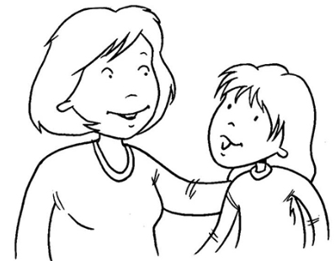
Tips on Political Disclosure
The research: Use Your Professional Judgment.
Have a heart to heart with yourself:
What are my non-negotiables?
When do I need to disclose my political beliefs? (Example: 1:1 with traumatized student)
Am I willing to give up some academic freedom to take a stand on an issue?

Slide 41
Handouts
*Publication in Social Education: “A Pathway to Racial Literacy: Using the LETS ACT Framework to Explore Controversial Issues”
*Racial Autobiography Guidelines
*Standards
*Children’s Literature
*Online Resources
*Dos & Don’ts of Role Play
* “They’re Not Too Young to Talk about Race” Research

Slide 42
Amazing Resources – Sign in & I will email you this list & handouts!
CRESST Facebook Group - Critical Resources for Elementary Social Studies Teachers
#SSCHAT - Twitter Group
Visions in Education - Social Studies Podcast
Teaching Tolerance
Facing History and Ourselves
Constitutional Rights Foundation Chicago
Choices Project: History and Current Issues for the Classroom
Rethinking Schools
The Howard Zinn Project
NewsELA
Social Studies and the Young Learner Journal
Teacher Social Justice Groups/Conferences nationwide
Elementary Social Studies Education Summit! - June 6-7, 2019!
Amazon Wish List for books

Slide 43
References
Aegis Trust. (2014, December 10). Peace education to enter Rwanda’s national curriculum. Retrieved March 7, 2018 from http://genocidearchieverwanda.org.rw/index.php/Welcome_to_Genocide_Archive_Rwanda
Bell, D., & Henning, M. B. (2007). DeKalb County, Illinois: A local history project for second graders. Social Studies and the Young Learner, 19(3), 7-11.
Bronson, P. and Merryman, A. (2009). Nurture shock: New thinking about children. New York, NY: Hachette Book Group.
Christ, R. C. (2018) Not an aberration of history: Genocide education in elementary social studies. In S. B. Shear, C. M. Tschida, E. Bellows, L. Brown Buchanan, & E. E. Saylor (Eds.) (Re)Imagining elementary social studies: A controversial issues reader (pp. 355-368). Charlotte, NC: Information Age Publishing, Inc.
Crazy Horse, R. (2002). The North American genocide. Rancocas, NJ: Powhatan Press.
Di’Angelo, R. “I’m leaving!”: White fragility in racial dialogue. (2006). In B. McMahon & D. Armstrong (Eds). Inclusion in Urban Educational Environments: Addressing Issues of Diversity, Equity, and Social Justice (213-240). Centre for Leadership and Diversity. Ontario Institute for Studies in Education of the University of Toronto.
Gangi, J.M. (2014). Genocide in contemporary children’s and young adult literature: Cambodia to Darfur. New York, NY: Routledge.
Guinier, L. (2004). From racial liberalism to racial literacy: Brown v. Board of Education and the Interest-Divergence Dilemma, The Journal of American History, 91(1): 92-118.
Henning, M. B., Snow-Gerono, J. L., Reed, D., & Warner, A. (2006). Listening to children think critically about Christopher Columbus. Social Studies and the Young Learner,19(2), 19-22.
Hess, D. (2009). Controversy in the classroom: The democratic power of discussion. New York, NY: Routledge.
Johnston, J., Anderman, L., Milne, L., & Harris, D. (1994). Improving civic discourse in the classroom: Taking the measure of Channel One. Research Report 4. Ann Arbor, MI: Institute for Social Research, University of Michigan.

Slide 44
References
Lukianoff, G. and Haidt, J. (2018). The coddling of the American mind: How good intentions and bad ideas are setting up a generation for failure. New York, NY: Penguin Random House.
McDevitt & Kiousis (2006). Deliberative Learning: An Evaluative Approach to Interactive Civic Education, Communication Education, 55:3, 247-264,DOI: 10.1080/03634520600748557
Naseem Rodríguez, N. & Ip, R. (2018). Hidden in history: (Re)constructing Asian American History in Elementary Social Studies Classrooms. In S. B. Shear, C. M. Tschida, E. Bellows, L. Brown Buchanan, & E. E. Saylor (Eds.) (Re)Imagining elementary social studies: A controversial issues reader (pp. 355-368). Charlotte, NC: Information Age Publishing, Inc.
National Council for the Social Studies, Expectations of Excellence: Curriculum Standards for Social Studies (Washington, D.C.: NCSS, 1994): 3.
Noddings, N. & Brooks, L. (2017). Teaching controversial issues: The case for critical thinking commitment in the classroom. New York: NY, Teachers College Press.
VanSledright, B., & Afflerbach, P. (2005). Assessing the status of historical sources: An exploratory study of eight elementary students reading documents. In P. Lee (Ed.), Children and teachers’ ideas about history, International Research in History Education, 4, (pp.1-20). London: Routledge/Falmer.

Slide 45
Thank you! Questions?
LETS ACT
A Framework for Teaching Controversial Current Events
LOVE & LISTEN - EDUCATE - TALK - SEARCH
ANALYZE - CONCLUDE - TAKE ACTION

